Slide 1

Signature Verification
System

Slide 2
Problem Statement
Manual signature verification issues:
Prone to human error
Time-consuming
Critical need:
Accurate, automated systems to combat forgery.
Applications Banking, legal authentication, and fraud detection.

Slide 3

Objective
Build a system to verify signatures efficiently and accurately.
Use BI-RNN for capturing sequential patterns and CNN for spatial analysis.
RNN (Recurrent Neural Network): Complements BI-RNN by processing longer-term dependencies when required.
Provide a scalable, user-friendly platform via Django.

Slide 4
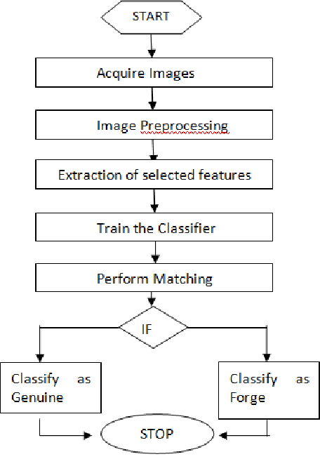
Methodology
Model Implementation:
BI-RNN captures sequential stroke features.
CNN extracts spatial details like curves and patterns.
RNN: Adds support for analyzing long-term sequential dependencies that may span the entire signature.
Deployment:
Django for real-time predictions via a web interface.

Slide 5
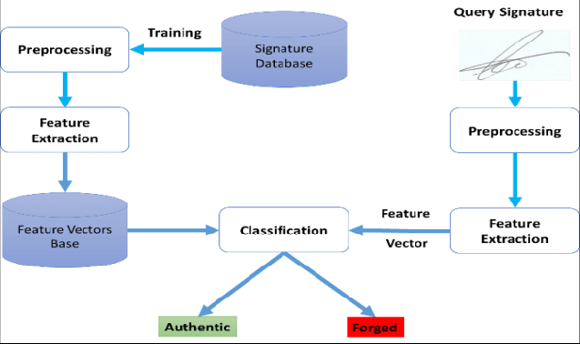
System Architecture

Slide 6

Results and Evaluation
Accuracy
Dataset: Trained on a dataset consisting of 360 genuine and 360 forged signatures.
Outcome: Robust model for real-time signature verification.

Slide 7
Challenges and Innovations
Challenges:
Limited dataset for diverse signature styles.
Managing model size for deployment in Django.
Innovations:
Hybrid BI-RNN + CNN approach.
Real-time web-based deployment

Slide 8
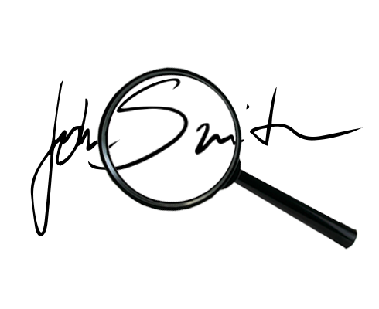
Conclusion and Future Work
Conclusion:
Developed a robust, automated signature verification system using BI-RNN, CNN and RNN.
Successfully deployed a scalable, user-friendly solution via Django.
Future Work:
Expand dataset diversity for improved generalization.
Optimize models for mobile and edge-device deployment.
Add support for multi-language and electronic signatures..

Slide 9
Thank You

